Slide 1

Customer Discovery - Week 4

Slide 2
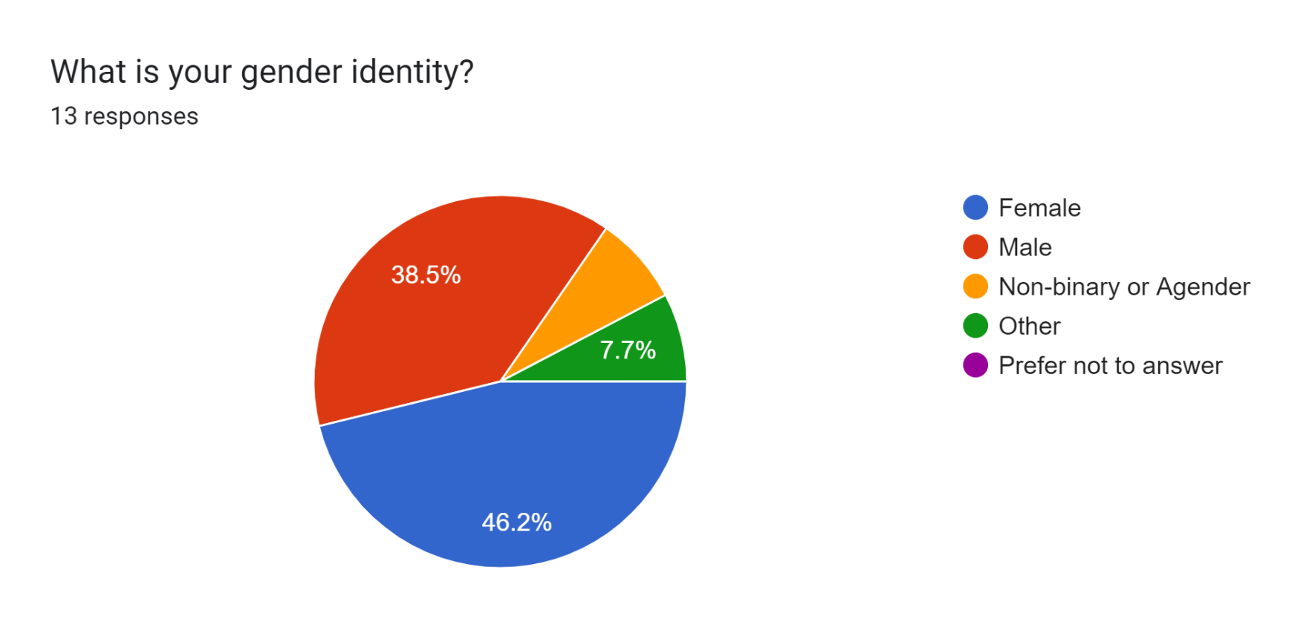
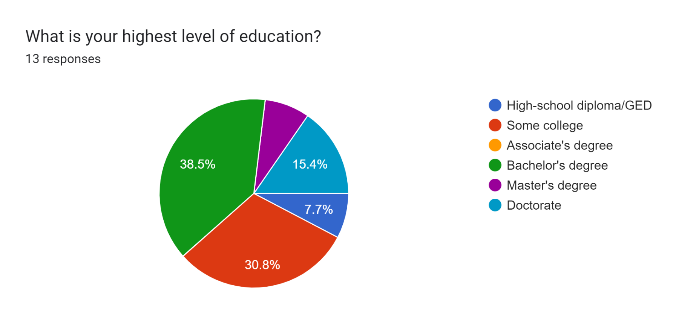
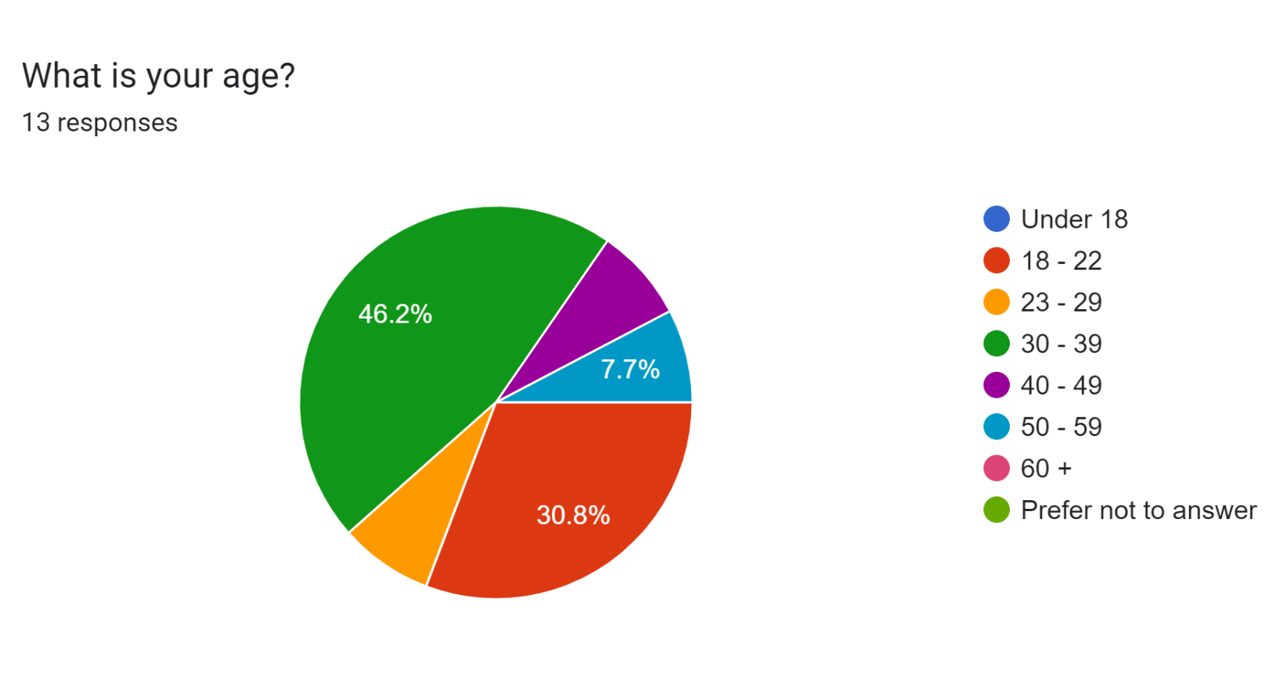
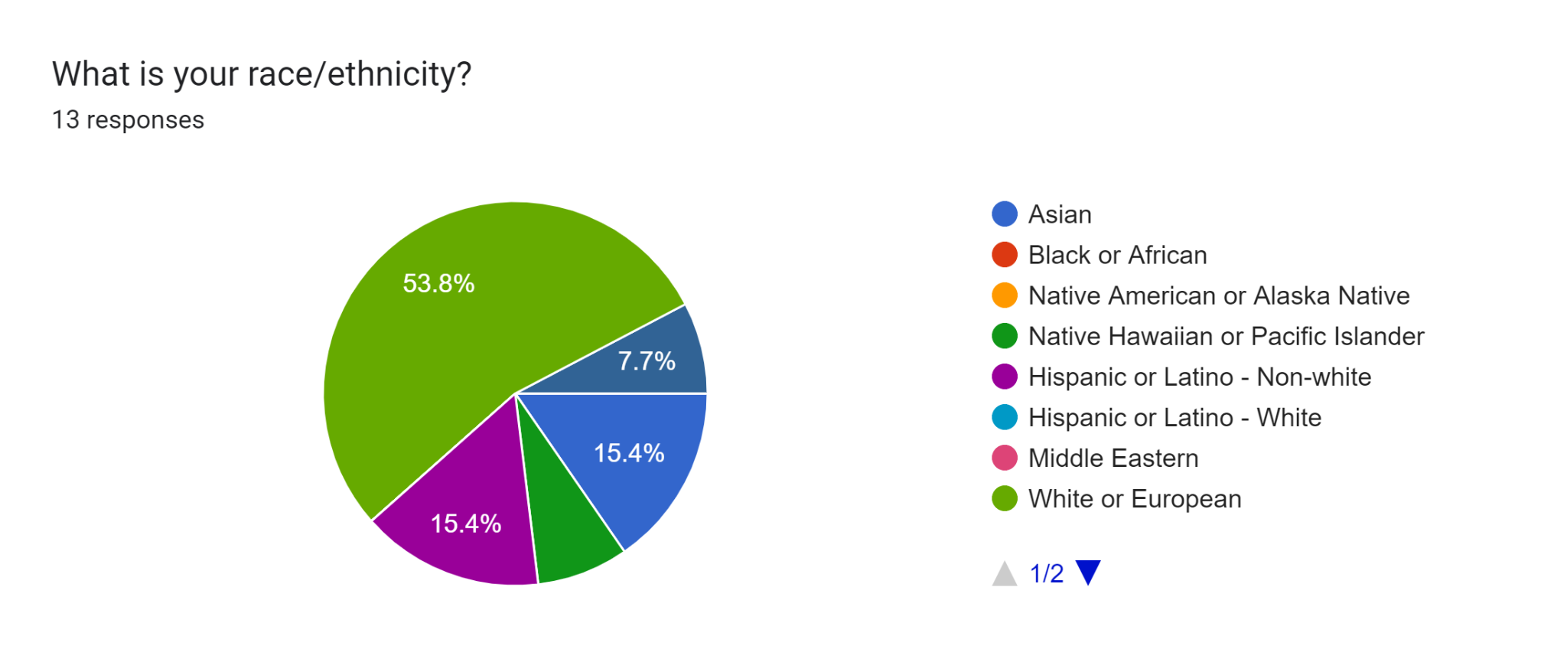
Demographic Information:

Slide 3

According to people who have tried supplement subscription services…
“They are terrible about sending you your package on time. Overall it’s cheaper but unreliable” -former customer of Care/Of
“I take care to read the research they provide for each of the vitamins they recommend for you, so if empirically-supported supplement use is something you value then I think care of does a really nice job summarizing the data. “ -former customer of Care/Of

Slide 4
According to people who have tried supplement subscription services…
“I stopped after a year due to disillusionment with the supplement industry, financial priorities ($30 per month), lack of observable “results” (even if just Ritual’s much-touted increased energy / improved mood)” - former customer of Ritual
“my biggest complaint is that the individual packaging is a little wasteful, but other than that my experience has been really positive!” -former customer of Care/Of

Slide 5
Key Takeaways
Sustainable packaging
Reliable shipping (comparable to HelloFresh)
Explain science behind product in as much detail as possible

Slide 6
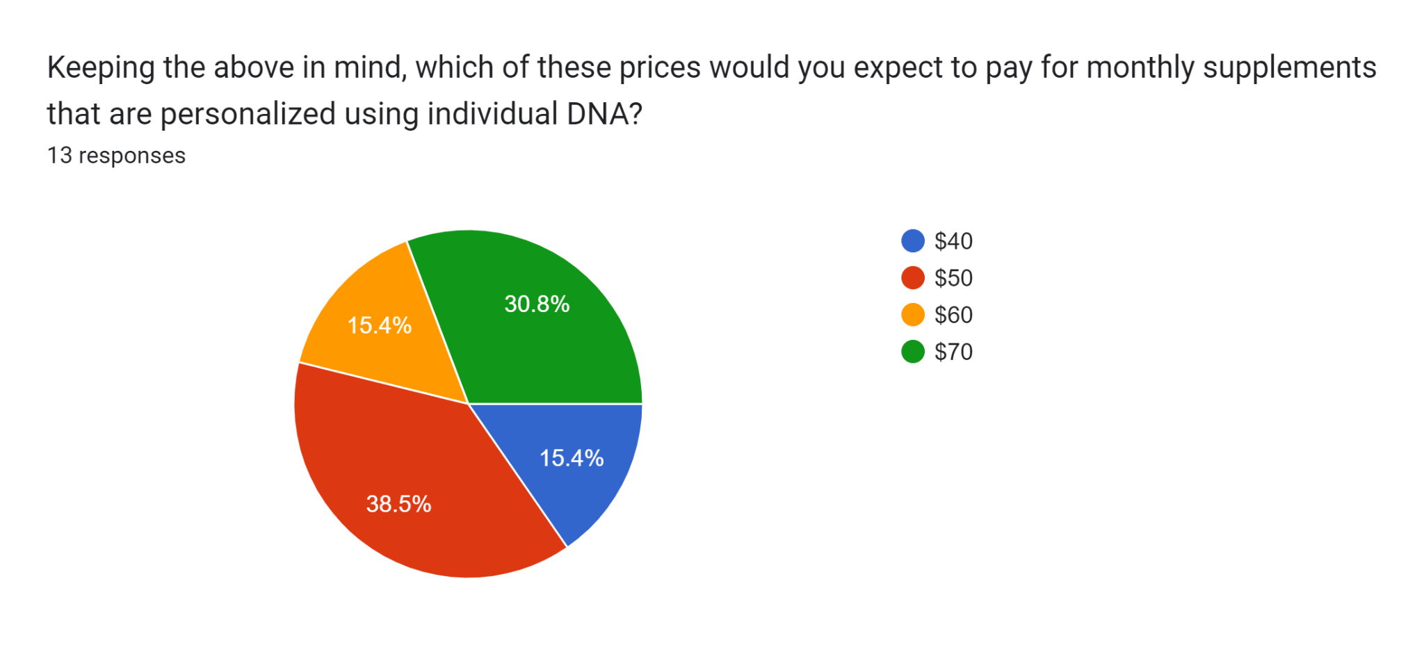
Supplement subscriptions that are currently on the market usually cost between $40 - $100 for each month of pills. These pills use consumer-reported data to inform supplement selection.

Slide 7
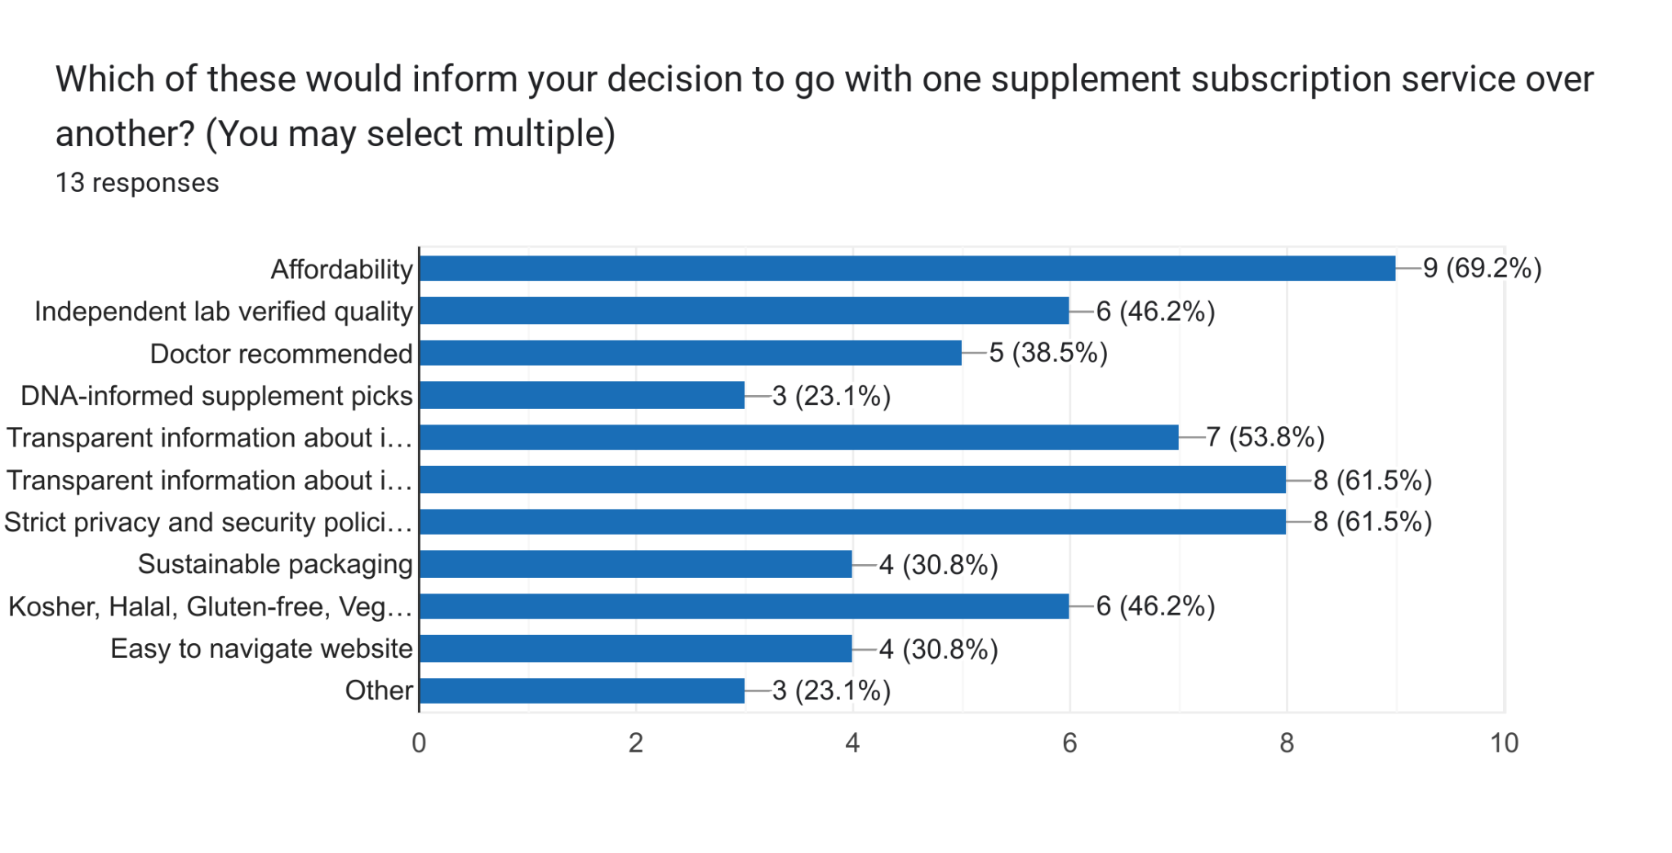
Affordability
Transparent information about ingredients’ efficacy
Strict privacy and security policies

Slide 8
If you checked "Other" on the previous question, what did you have in mind?
“I would not go for a suplement subscription. As far as I am concerned, suppelements do not actually provide anything useful (as per medical studies)”
“I would not go for a suplement subscription. As far as I am concerned, suppelements do not actually provide anything useful (as per medical studies)”
“Someone in charge or endorsing the product being of an ethnic/gender/sexual/religious minority”

Slide 9
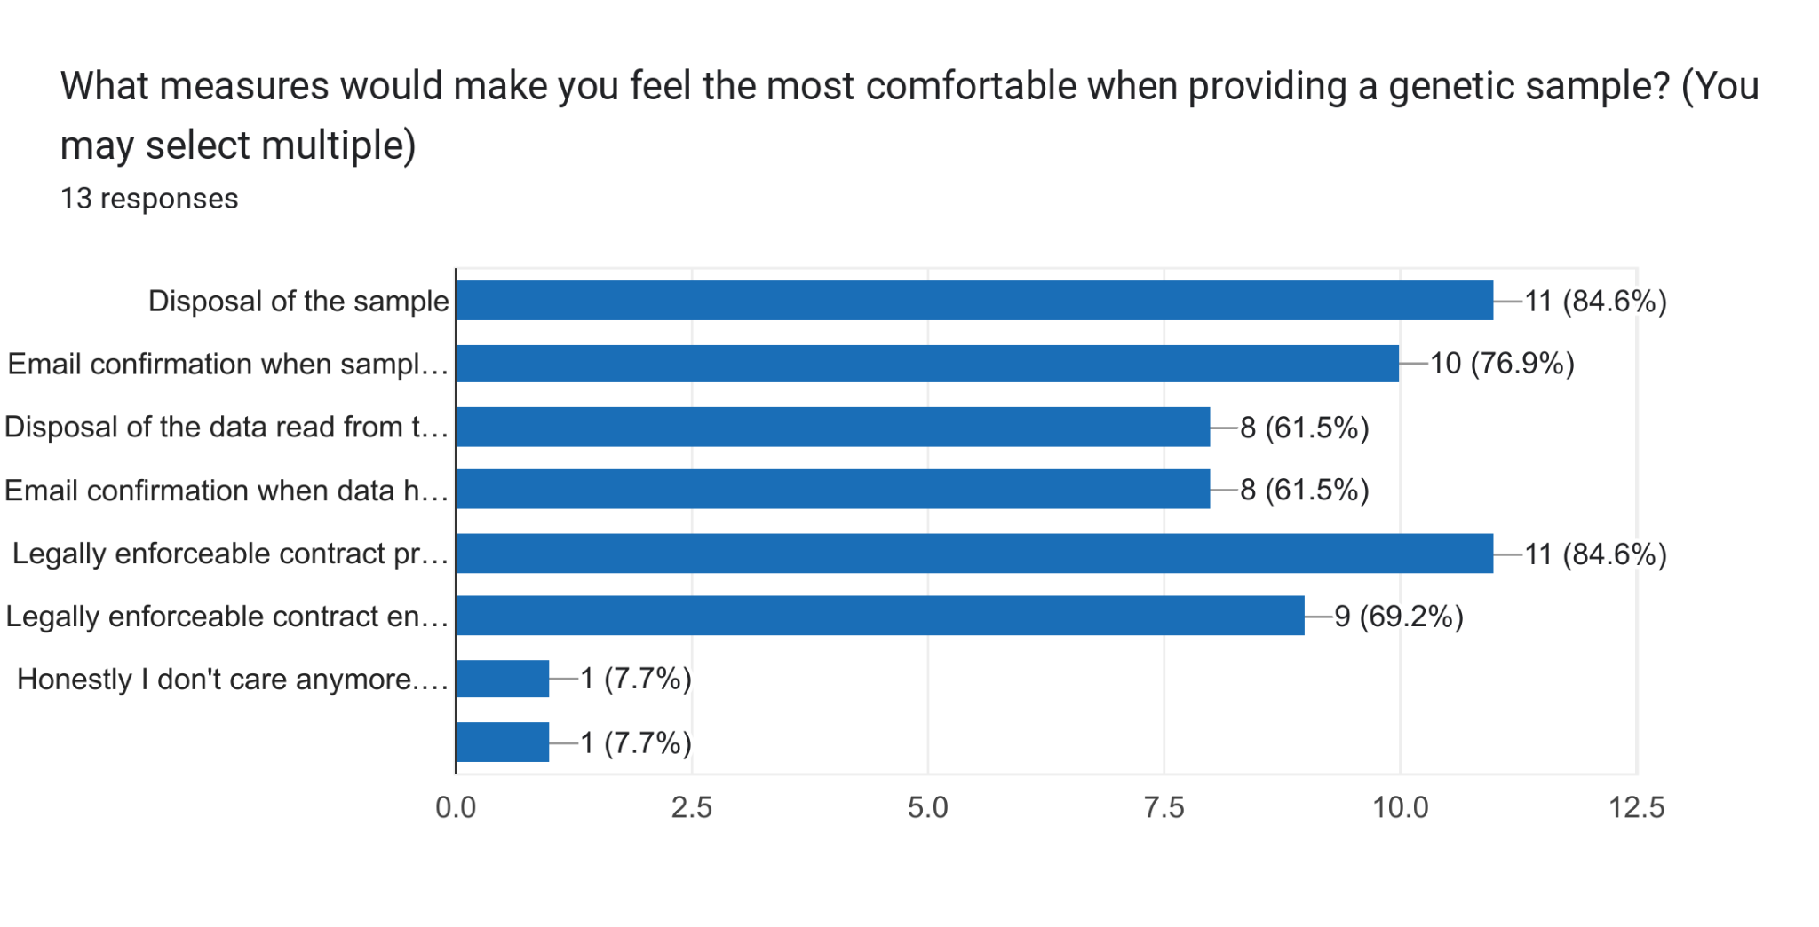
Disposal of the sample
Legally enforceable contract preventing the sale or transfer of genetic data
“Honestly I don’t care anymore. I worked in genetics research and I’m sure all my DNA info is already out there if someone cared to find it”

Slide 10
Additional Feedback
“It seems like a standard blood test would be a cheaper, easier, and better way to determine what nutrients a person was deficient in.”
“Also, you might run into trouble with the FDA if you're claiming to diagnose nutrient deficiencies; that would be regulated like any other diagnostic (which is to say, significant regulatory burdens).”
“It seems like storing the data might actually be preferable. You could track progress and study the effects of your supplements on gene expression. How else would you show that they're actually working?”
“Also, you might run into trouble with the FDA if you're claiming to diagnose nutrient deficiencies; that would be regulated like any other diagnostic (which is to say, significant regulatory burdens).”

Slide 11
Questions?

